Slide 1
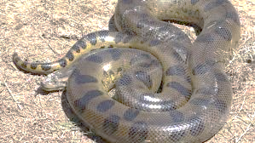
The Anaconda plan
Civil war unit lesson 7

Slide 2
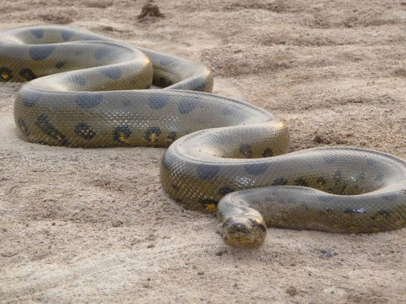
Why the Anaconda Plan?
Developed by Winfield Scott.
What was the Goal?
Defeat the rebellion by blockading southern ports and controlling the Mississippi river.
Outcomes if Goal Achieved:
Cut off and isolate the South from the outside world.
Prevent the south from sending and receiving food and supplies

Slide 3
Called “Anaconda Plan” because the approach seemed like a constriction similar to that of an Anaconda snake.
George McClellan was a commanding officer of Union forces
Did not support or condemn the plan
McClellan wanted to ravage Richmond, a key southern city
Not everyone in agreement
Still used several tactics from the plan in the war
Ultimately never used

Slide 4
Arguments:
For: fewer deaths would have occurred because they would have stopped it at the source
Against: blockading would not win the war but would just place a Band-Aid over the problem.
Objectives:
Set up a naval blockade of the Atlantic and Gulf of Mexico ports
GOAL-block trade
Transport roughly 60,000 Union troops in 40 steam transports escorted by upwards of 20 steam gunboats down the Mississippi river.
GOAL- capture and take control of forts and towns along the way.

Slide 5
Critical thinking question: Why would scott not have agreed with mcclellan’s suggestion?
Helping Questions:
What did McClellan suggest?
What did Scott suggest?
Which would have caused more fighting?
McClellan argues that the way to win the South is not in blockading ports but in ravaging Richmond, a key city of the war.
Arguments for and against the Anaconda Plan:
For: fewer deaths would have occurred because they would have stopped it at the source
Against: blockading would not win the war but would just place a Band-Aid over the problem

Slide 6
