Slide 1
The Home Front

Slide 2
The Home Front
The Civil War touched the lives of every American family, North and South.
Notes:
Almost every family had a son, husband, sweetheart, brother or father away at war. For those who remained behind, the Civil War changed their lives forever.
Discussion Questions:
What does the kneeling woman symbolize?
What is the soldier doing?
Look at the pictures along the bottom of the slide. Describe the actions taking place.

Slide 3
The Role of Women
What’s the difference?
North
South
Life must go on. Women North and South take over men's work
Notes:
Notes for the Teacher: With so many men at war, women had to take on more responsibility. In the South, women on plantations took charge, serving as plantation mistresses and managing vast numbers of slaves while their husbands were away at war. Most Southern women took on the back-breaking strain of agricultural labor, often doing work that their husbands and sons would normally have done. In the North, women bore the brunt of manufacturing jobs or the farm work and were vital to the success of the war effort to supply the Union army.
Discussion Question:
What jobs did women take up when the men were called to war?

Slide 4
The Role of the Family
Children working at home
Notes:
Children worked the fields for the family while their fathers and older brothers were away at war.
Discussion Question:
Why would the children have to work in the fields more?

Slide 5
The Role of the Family
Tillie Pierce was a 15 year old teenager on July 1, 1863 when she left Gettysburg with her family to escape the battle. She found herself nursing the wounded at the J. Weikert Farm south of town. Care of wounded soldiers continued upon returning to the family home, and in almost every home and building in Gettysburg for months after the battle. Tillie later wrote about her experiences in an article, “What a Girl Heard and Saw of the Battle.”
Notes:
Discussion:
Do you think that children were often caught in battle?
Were children near battles more in the North or South? (Answer Information: most battles were fought in the South, which directly affected the lives of those on the home front, sometime with battles being fought in their own backyards)

Slide 6
Challenging Times
Shortages became so severe that in 1863 the women of Richmond marched on the government in a “Bread Riot.”
Notes:
Discussion Question:
Why do you think women rioted in Richmond, Virginia? Why do you think it was just women?

Slide 7
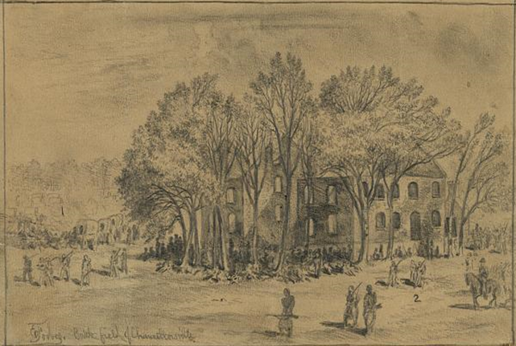
Challenging Times
Civilians who had homes near battles often had their homes destroyed or taken over for use as field hospitals.
The Chancellor family was trapped between the armies in May 1863 when their home became General Hooker’s Headquarters.
Notes:
Image information:
Battlefield of Chancellorsville House after the Battle
Notes:
Sue Chancellor was 16 in May 1863 when her home was between the armies and General Hooker took it for his headquarters. She left a detailed description of the ordeal she faced in company with 15 other women and girls, including relatives, neighbors, and a young abandoned black girl. Water stood shin deep in the basement where they crouched for protection.
“Oh! Such cannonading on all sides,” Sue wrote of May 2, “such shrieks and groans, such commotion of all kinds!”
Her home became a hospital, the grand piano became the amputating table. Arms and legs were thrown out the window. The house caught fire from shelling and burned to the ground. Luckily all the family got out alive.

Slide 8
Challenging Times
Those on the home front had to meet the needs of their family as well as support the needs of the army.

Slide 9
Transportation of Information
Notes:
Newspaper reading reached an all-time high.
People scanned the newspapers every day for news of the war or their home.

